Slide 1
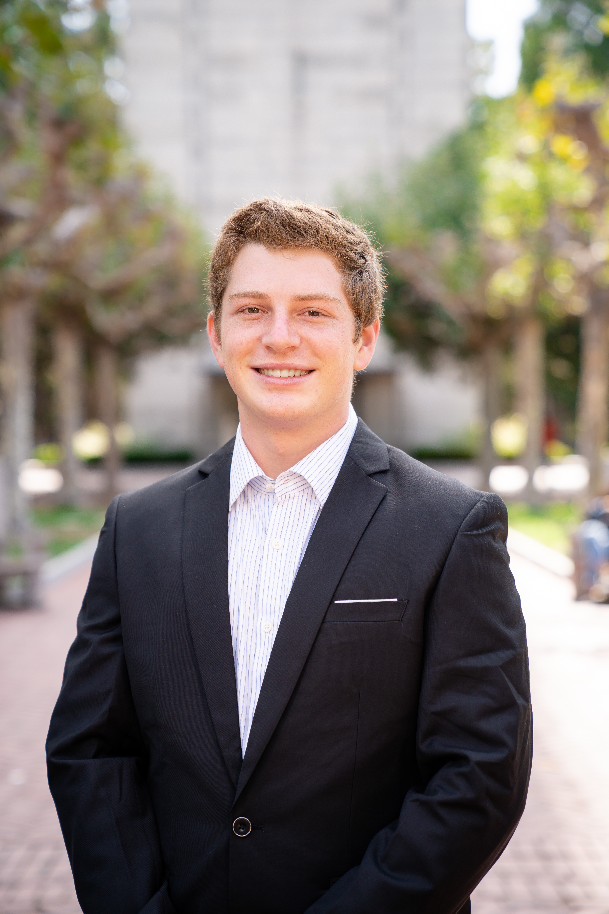

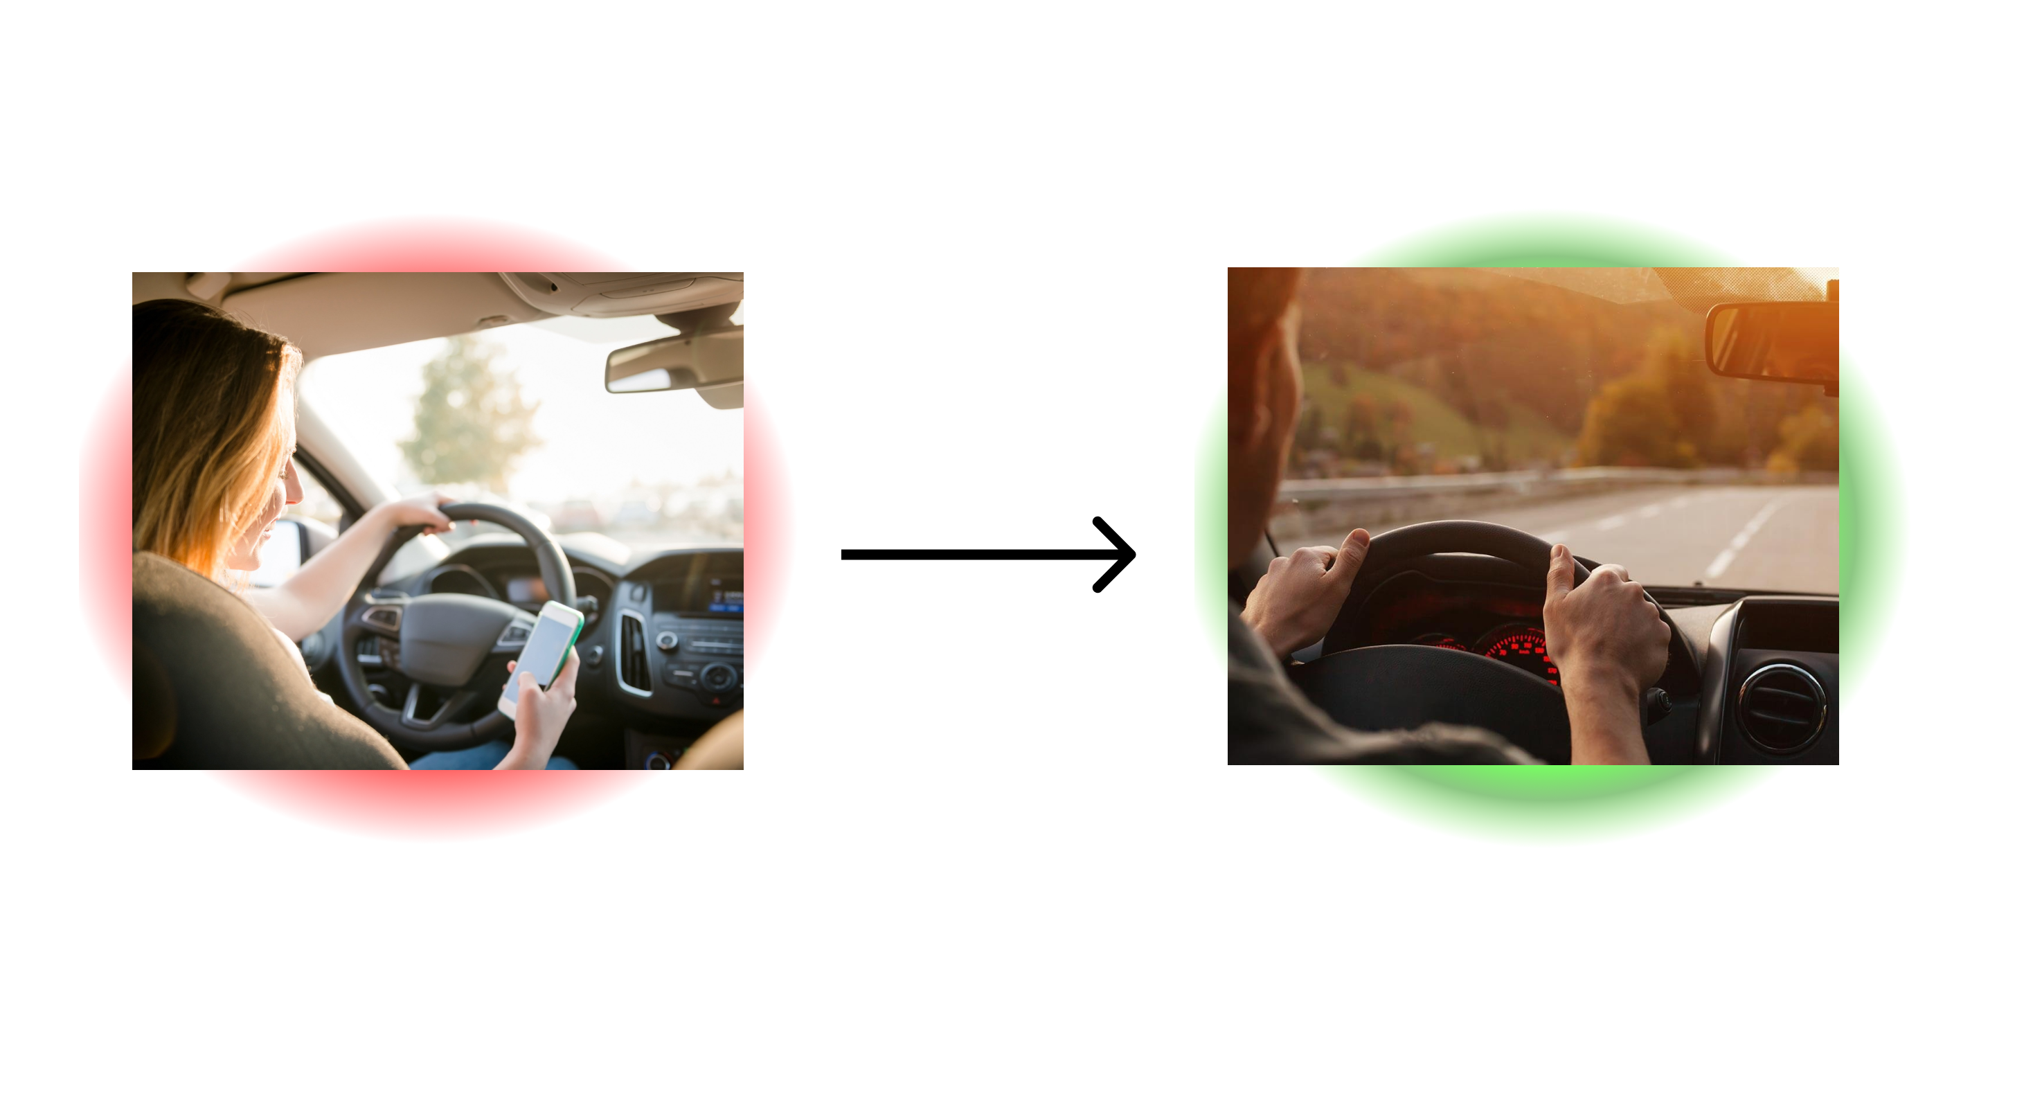
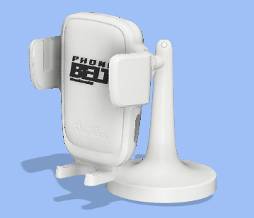
PhoneBelt
07/23/23
Business Thesis:
Make roads safer by offering actionable improvement suggestions
Parents of teenage drivers
Urge to keep tabs on their family and eagerness to keep them safe
James Coleman

Slide 2





The Business Model Canvas
Designed for: PHA & CREA
Designed by: James Coleman
Date: 06/27/23
Version: 2
Key Partners Driving schools Gov agencies that promote safe driving or involved with driving at all (DMV) Distracted driving related charities, foundations and non-profits School districts hosting distracted driving awareness week/ red ribbon week & districts that allow students to purchase on-site parking passes Community safe driving advocates. Government officials Occupational safety organizations/ government arms Parenting social media platforms and their moderators Existing indirect competitors or companies in this space that are willing to collaborate in mutually beneficial ways | Key Activities Build product Talk to customers Find and apply to grants Add workers or cofounders | Value Propositions Parents: Provide parents the Maslov need of security and safety Reduce time spent checking on family members and reduce time spent coaching young drivers Potentially reduce insurance costs Teens Provide the tools to actionably improve driving Put money in your pocket and reward safer driving |  | Customer Relationships Initially a hands-on onboarding relationship Continually provide value to customer via ongoing solutions Offer lots of customer support to create ongoing relationship | Customer Segments Parents of teenage drivers, especially those using existing solutions like Life360 Rideshare drivers who cannot access UBI currently Commercial Door to Door driving, especially the ones that do not use a driver facing camera solution Car insurance companies and organizations Vehicle rental companies
 | Key Resources App developers Cash for building team Insurtech conference/ accelerators/ connections (industry and legal knowledge) Contract Manufacturer for hardware |  |  | Channels Earned media (novel and controversial product) Social media marketing Kickstarter Targeted selling through key partners Pilots with key orgs/ gov arms Paid acquisition via ads
Cost Structure Hardware Costs COGS (landed) - $15 SG&A – $10 Certification costs (12k) App costs Cloud computing and storage costs (Storage, Inbound, Outbound, Compute per gig TBD) |  |  | Revenue Streams Freemium subscription model {free, silver, gold}

Slide 3
You will interview at least two people before Session 2b and report out on those interviews during that session.
List the 5-6 people in your customer segment that you will request an interview with.
Person 1
Name: Peter Selby
Title or position: Professor
Company/organization: Cornell
Email or phone: selbypc@gmail.com
Date of interview:
Person 4
Name: Stu Penrose
Title or position: CTO
Company/organization: Holler
Email or phone: 661-332-4407
Date of interview:
Person 2
Name: Hadak Gazi
Title or position: Parent
Company/organization: NA
Email or phone: hadaskg@gmail.com
Date of interview: 07/24
Person 5
Name: Lauren Farrell
Title or position: Risk Manager
Company/organization: Enterprise
Email or phone: Linkedin
Date of interview:
Person 3
Name: Lindsay Wang Parent
Title or position: Parent
Company/organization: NA
Email or phone: Slack
Date of interview:
Person 6
Name: Josh Patrick
Title or position: Director of Technology Procurement
Company/organization: Geico
Email or phone: Linkedin
Date of interview:

